Slide 1
Pneumonia Detection from Chest Xrays
Aishwarya Saad Shariff – May 2020

Slide 2
Backstory – Pneumonia Study
Introduction to Project
What is Pneumonia?
Whom does it effect?
Types of Pneumonia
How is it diagnosed?
Why should we be concerned?
Problem Statement
Need of the study / project
Business / social opportunity

Slide 3
Data Report Data Source - study conducted by NIH Clinical Center, Maryland, USA
Data collected : frequency
Data collected : time
Data collected : methodology
112,120 frontal-view X-ray
51,708 with known pathologies
Subset of this is used in this project
32,717 unique patients
Time period 1992 - 2015
Image
Dicom – 1024 * 1024
B-box
Radiologist identified
Labeling
NLP techniques

Slide 4





Model Building
Dataset : Kaggle RSNA Pneumonia detection challenge
https://www.kaggle.com/c/rsna-pneumonia-detection-challenge/data.
Structure :
Folder 1 : Train Images (26,684)
Folder 2 : Test Images (3000)
CSV File 1 : Train Images Bbox info
CSV File 2 : Train Images Target class info

Slide 5
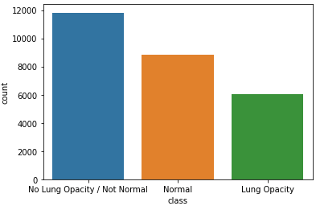
Exploratory Data Analysis
Renamed column
Dropped Duplicate Patient info
Replaced NaN from BBox coordinates
Combined both CSV info into one Dataframe
Descriptive Analysis - DICOM metadata
Converted images from DCM to PNG
Distribution of Target Classes

Slide 6
Modeling
Define DataGenerator
Define custom Loss
Create, Compile, Fit, Evaluate and Predict Model
MobileNetV2 – feature extractor (Encoder)
Skipnet – decoding methodology (Decoder)
Optimizer – Adam
Metric - Accuracy

Slide 7
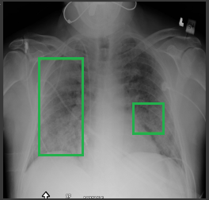
Results
Accuracy : 98.54%
Recommendations :
Less noisy dataset
More versatile library
More labeled data
Image augmentation
Balance the classes

